Slide 1
History of Programming Languages, OOP Principles and Structured vs Object Oriented Programming
Presented By:-
Bibek Sharma
MCA 2nd Sem
Roll No 28

Slide 2
FORTRAN
Fortran was the first effectively implemented high-level language that introduced variables as we know them now, loops, procedures, statement labels and much more.
Mainly used for scientific calculations.
It is still widely used in engineering applications that require much array manipulation.

Slide 3
FLOWMATIC
The first language suitable for business data processing.
First to have heavy emphasis on an "English-like" syntax.
IPL-V
The first - and also a major - language for doing list processing.

Slide 4
COMIT
The first realistic string handling and pattern matching language
Most of its features appear (although with different syntax) in any other language attempting to do any string manipulation.
COBOL
One of the most widely used languages on an absolute basis, and the most widely used for business applications.
Elaborate data structures, record type introduced for the first time.

Slide 5
ALGOL 60
It was the first to have block structure, recursion, and a formal definition.
It is not used now, but it is the ancestor of most contemporary languages.
As far as design goes, Algol 60 was without doubt the most important innovation in the history of programming languages so far.

Slide 6
LISP
One of the earliest programming languages.
Based on the concept of computing by evaluating functions.
Very good for symbolic computing.
For years, the only language for Artificial Intelligence work.

Slide 7
PL/I
A combination of features believed (at the time) best in Fortran, Algol 60, Cobol.
the first language designed to be completely general, good for all possible applications
actively promoted by IBM
not used much today.
An interesting feature introduced in PL/I: Event Handling.

Slide 8
BASIC
The first in history language of personal computing.
The first programming language for many programmers designed to be easy to learn.
Very simple, limited, though still general-purpose.
Present-day versions of Basic are full-fledged languages—not "basic", and not easy to learn any more.

Slide 9
SIMULA 67
An extension of Algol 60 designed for simulation of concurrent processes.
Introduced the central concepts of object orientation: classes and encapsulation.
Predecessor of Smalltalk and C++.
Now unused.

Slide 10
PASCAL
A conceptually simplified and cleaned-up successor of Algol 60.
A great language for teaching structured programming.
Teaches good programming habits.
Its later extensions (for example, Delphi) are full-fledged systems programming packages, as powerful as any Java kit.

Slide 11
Ada
The result of an elaborate, multi-stage design process, and a more successful attempt at generality than PL/I.
Completely standard: there can be no dialects (like Java, except that Microsoft...).
There are, however, two standards: Ada 83 (the original), and Ada 95.
Ada has been designed to support concurrency in a very neat, systematic way.

Slide 12
C
The implementation language of Unix.
A great tool for systems programming and a software development language on personal computers.
Once fashionable, still in use, but usually superseded by C++.
Dangerous if not used properly : not recommended to novice programmers.
Relatively low-level.

Slide 13
Smalltalk
It is the purest object-oriented language ever designed (till now), cleaner than Java, much cleaner than C++.
Comes complete with a graphical interface and an integrated programming environment.
In skilled hands, a powerful tool.

Slide 14
C++
An object-oriented extension of the imperative language C.
This is a hybrid design, with object orientation added to a completely different base language.
Complicated syntax, difficult semantics.
Very fashionable, very much in demand.

Slide 15
Java
A neat, cleaned up, sized-down reworking of C++.
Derive much of its features from C(for syntax) and C++(object oriented approach).
Platform independent.
Full object orientated.
Designed for Internet programming, but general-purpose.

Slide 16
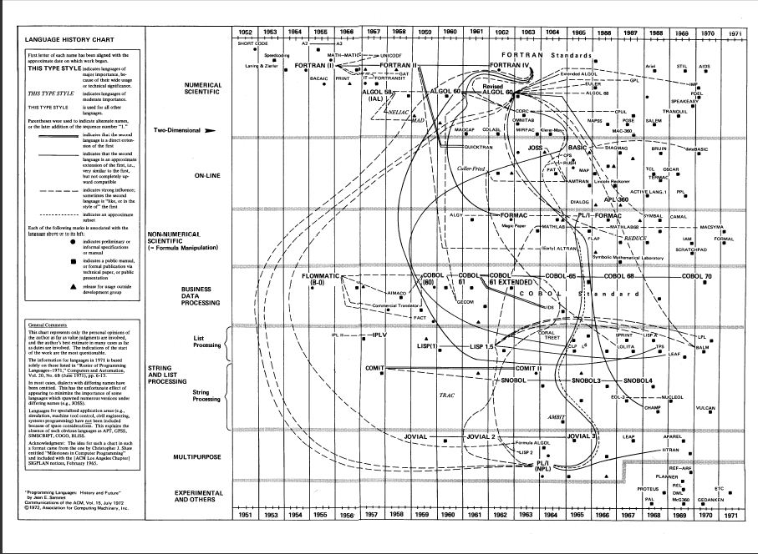

Slide 17
OOP PRINCIPLES
Abstraction
The act of representing essential features without including the background details or explanations.
For example : A car.
A powerful way to manage abstraction is through the use of hierarchical classifications.

Slide 18
Oop principles contd….
Encapsulation
The wrapping up of data and functions into a single unit.
Not allowing tampering of data.
Consider the automatic transmission on an automobile
Basis of encapsulation is the Class.

Slide 19
Oop principles contd….
Inheritance
It is the process by which objects of one class acquires the properties of objects of another class.
For example : Birds.
In OOP, the concept of inheritance provides the idea of reusability.
This means adding additional features to an existing class without modifying it.

Slide 20
Oop principles contd….
Polymorphism
It is a feature that allows one interface to be used for a general class of actions.
The ability to take more forms.
“One interface, multiple methods”.
For example : A Stack.
If the dog smells a cat, it will bark and run after it. If the dog smells its food, it will salivate and run to its bowl.

Slide 21
Structured vs Object Oriented Programming
1. Emphasis is on doing things (algorithms). | 1.Emphasis is on data rather than procedure.
2.Large programs are divided into smaller programs known as functions. | 2.Programs are divided into what are known as objects.
3.Data move openly around the system from function to function. | 3.Data is hidden and cannot be accessed by external functions.
4.Employs top - down approach in program design. | 4.Follows bottom - up approach in program design.
5.Complexity increases with large programs. | 5.Complexity can be reduced using OOP principles.

Slide 22
REFERENCES
Programming Languages: History and Future - Jean E. Sammet IBM Corporation
Object – Oriented Programming with C++ - E Balagurusamy

Slide 23
RESEARCH TOPIC
COMPUTATIONAL NEUROSCIENCE.

Slide 24
thankyou

